Slide 1
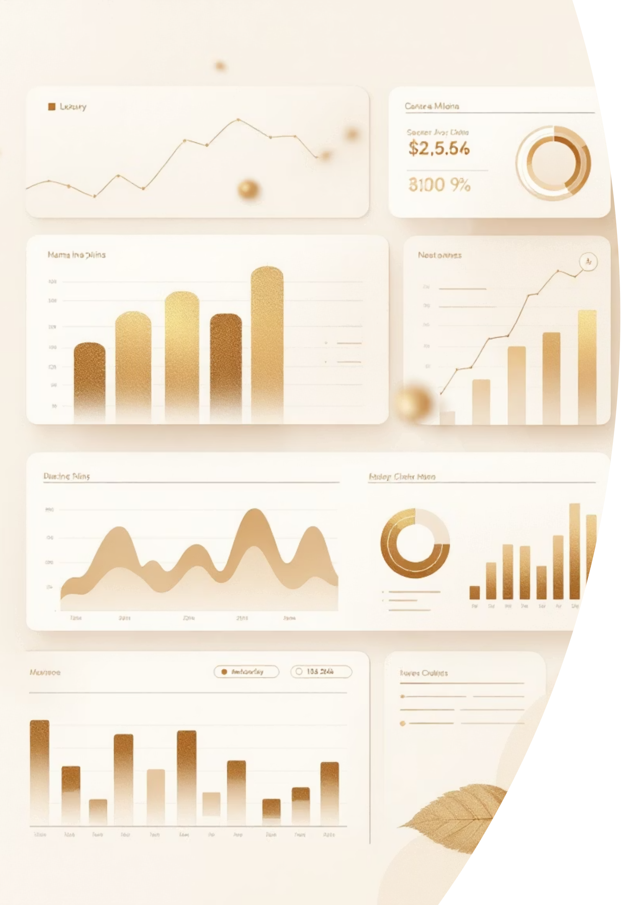
Customer Behaviour Analysis using Python, SQL, and Power BI
An end-to-end data analytics project transforming raw customer data into actionable business insights
Tools Used: Python • SQL • Power BI • Gamma AI

Slide 2
The Business Challenge
Understanding Customer Behaviour in a Competitive Market
Key Questions
Who are our most valuable customers?
In today's rapidly evolving retail landscape, businesses face significant challenges in understanding what drives customer purchasing decisions. Without clear insights into customer behaviour patterns, companies struggle to optimize their marketing strategies, inventory management, and revenue growth initiatives.
What drives purchase decisions?
When do customers shop most?
Which products generate highest revenue?
Organizations need a comprehensive analytical framework to decode customer preferences, identify high-value segments, and uncover hidden trends that influence purchasing behaviour. This project addresses these critical business needs through systematic data analysis.

Slide 3






Project Objectives
Identify Revenue Drivers
Analyze product categories, customer segments, and seasonal trends that contribute most significantly to overall business revenue
Segment Customers
Profile customers based on demographics, purchase behaviour, and value contribution to enable targeted marketing strategies
Uncover Patterns
Discover hidden trends in shopping behaviour, purchase timing, and product preferences to inform business decisions
Provide Insights
Deliver actionable recommendations that directly support strategic planning, inventory optimization, and marketing effectiveness

Slide 4
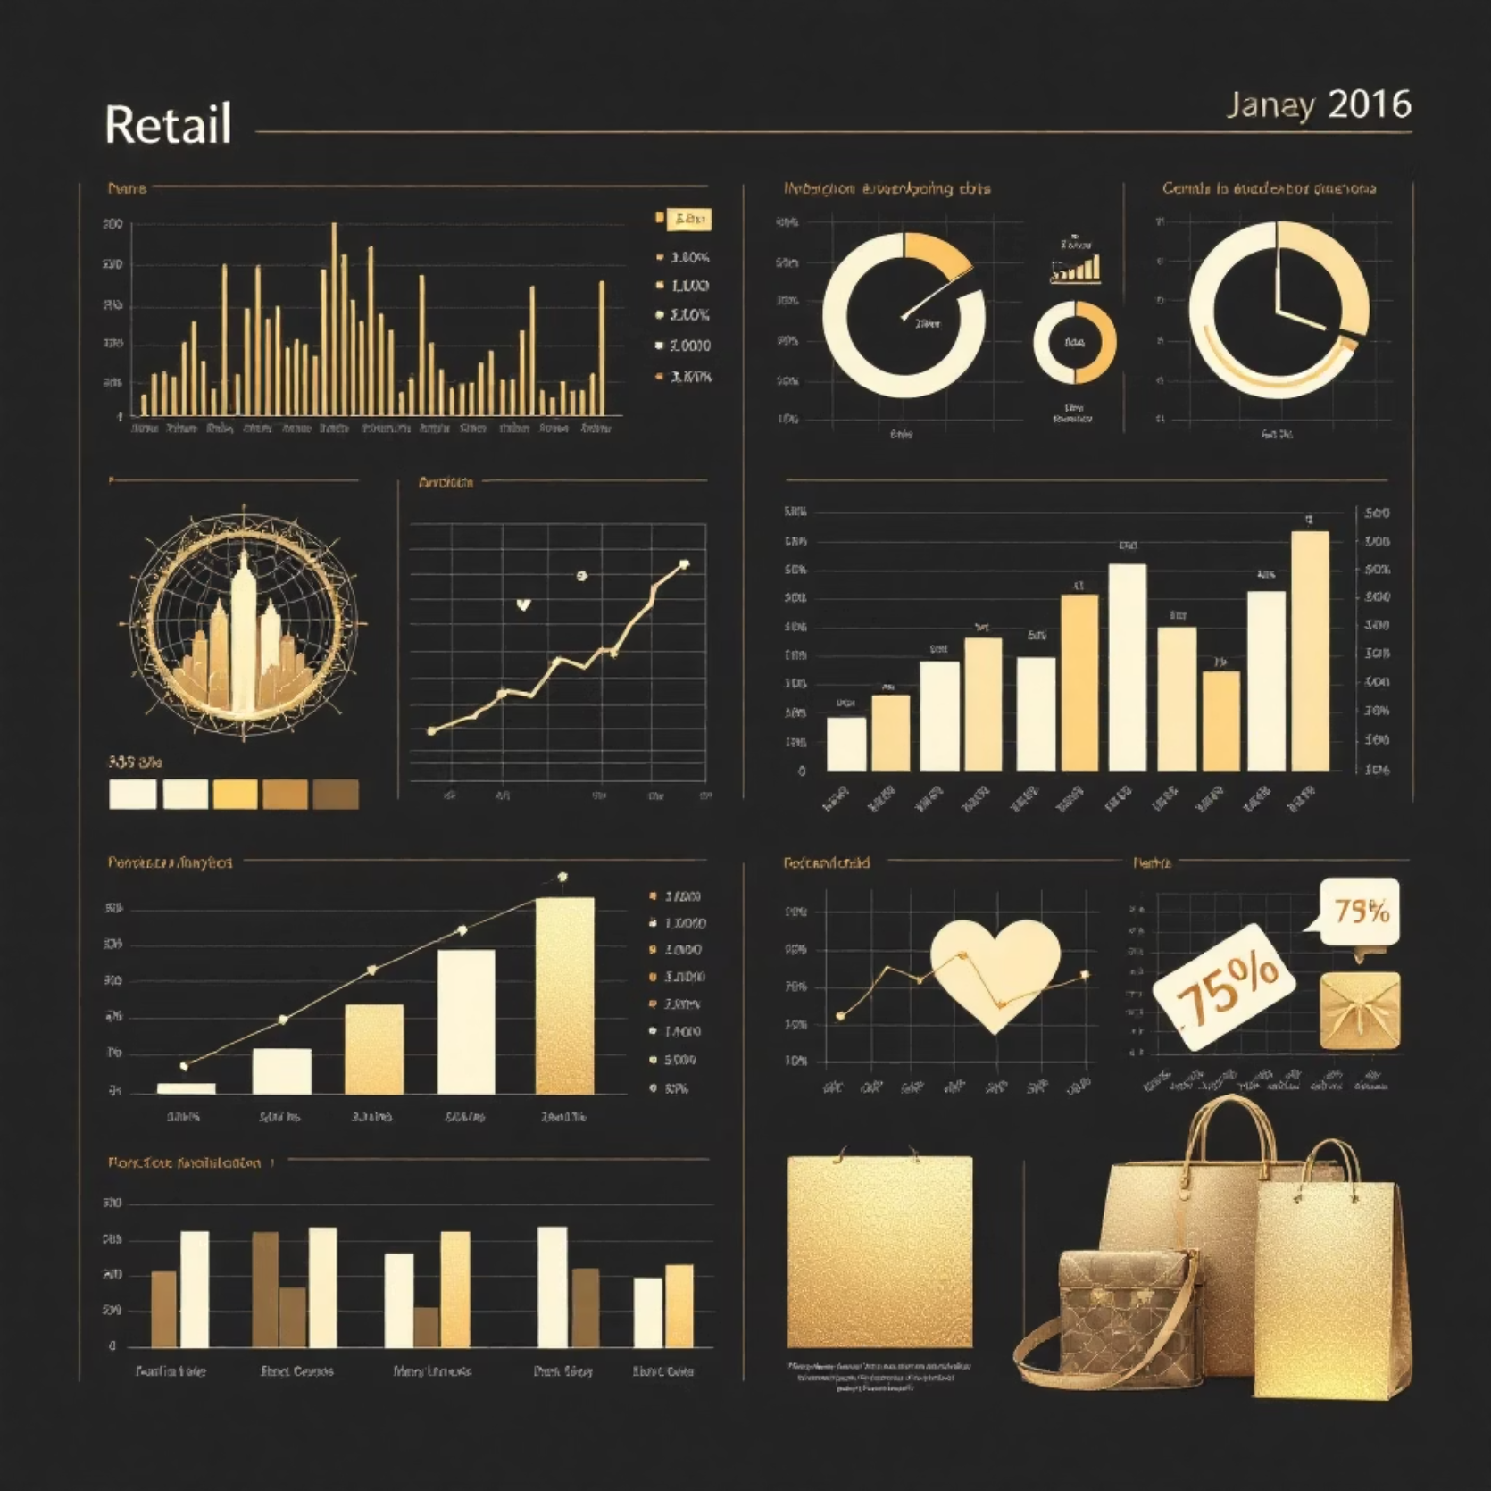
Dataset Overview
Customer Shopping Data
The analysis leverages a comprehensive retail dataset containing transactional records from a multi-category retail business. This dataset provides a realistic foundation for understanding customer purchasing patterns across different product categories, demographics, and time periods.
Transaction Details
Invoice numbers, purchase dates, product categories, quantities, and prices
Customer Demographics
Age, gender, location, and customer identification attributes
Payment Information
Payment methods and total transaction values for revenue analysis

Slide 5




End-to-End Analytics Workflow
A systematic approach to transforming raw data into business intelligence
Raw Data
Customer shopping transactions with multiple attributes and potential quality issues
Python Processing
Data cleaning, transformation, and exploratory analysis to prepare quality datasets
SQL Analysis
Complex queries answering critical business questions and aggregating insights
Power BI Visualization
Interactive dashboards presenting KPIs and trends for stakeholder consumption
Actionable Insights
Strategic recommendations driving business decisions and growth initiatives

Slide 6


Data Preparation & Exploratory Analysis
Python-Powered Data Engineering
Data Cleaning & Transformation
The initial phase involved rigorous data quality assessment and preparation using Python's pandas library. Missing values were identified and handled appropriately, duplicate records were removed, and data types were standardized to ensure analytical accuracy.
Handled missing values across 8 key columns
Removed duplicate transactions (approximately 3% of records)
Standardized date formats and categorical variables
Created derived metrics including total purchase value and customer lifetime metrics
Validated data integrity through statistical profiling
Exploratory Findings
Gender Distribution: 68% female customers, 32% male customers
Age Range: Customers aged 18-64, with highest concentration in 25-45 bracket
Product Mix: Clothing dominates with 45% of transactions, followed by technology and cosmetics
Key Libraries Used: pandas for data manipulation, NumPy for numerical operations, matplotlib and seaborn for visualization

Slide 7


SQL Business Analysis
Answering Critical Business Questions
1
2
Revenue by Category
Customer Value Segmentation
Which product categories generate the highest revenue? Analysis revealed clothing and technology as top performers, contributing over 60% of total revenue.
Who are our high-value customers? Identified top 20% of customers generating 55% of revenue, enabling focused retention strategies.
3
4
Temporal Patterns
Payment Preferences
When do customers shop most? Discovered peak shopping periods during weekends and month-end cycles, informing promotional timing.
How do customers prefer to pay? Credit card transactions account for 48%, followed by cash (32%) and digital wallets (20%).
5
6
Geographic Analysis
Demographic Insights
Where are our best-performing markets? Urban centers show 3x higher transaction density compared to suburban locations.
What customer profiles drive sales? Female customers aged 25-40 represent the highest value segment with strongest repeat purchase rates.

Slide 8
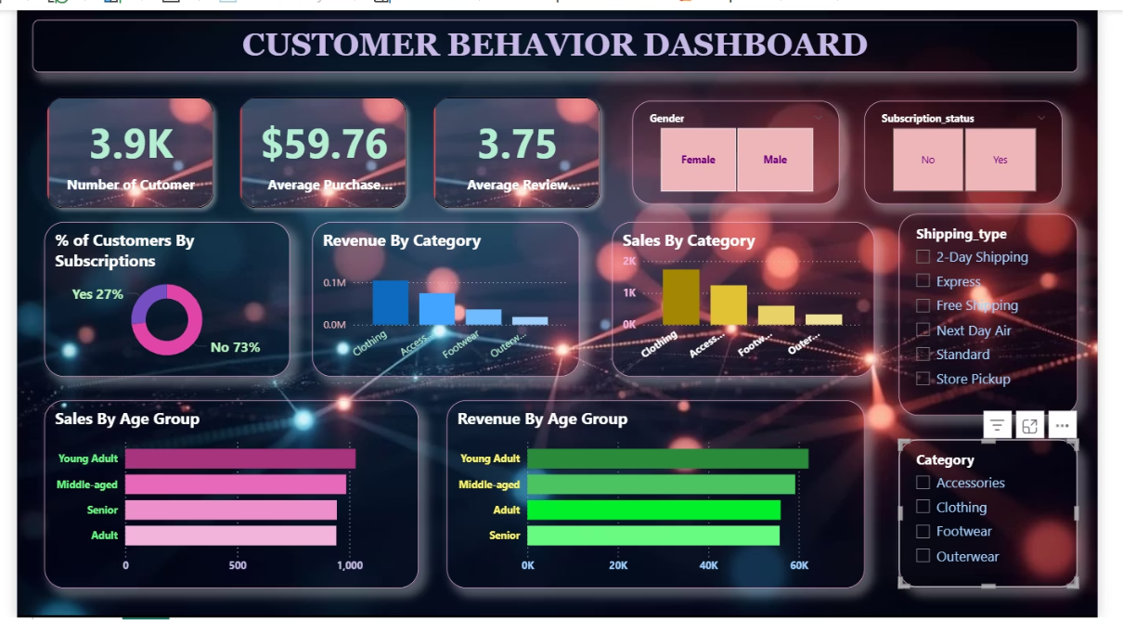
Power BI Dashboard Overview
Interactive Business Intelligence
The Power BI dashboard transforms complex analytical outputs into intuitive, interactive visualizations that enable stakeholders to explore data and derive insights independently. The dashboard features drill-down capabilities, dynamic filtering, and real-time KPI monitoring.
Key Performance Indicators
$2.4M
15.2K
Dashboard Features
Total Revenue
Active Customers
Revenue trends by month, category, and customer segment
Year-to-date revenue across all categories
Unique customers with purchases in analysis period
Geographic heat maps showing regional performance
Customer demographic breakdowns with interactive filters
Product performance comparisons and inventory insights
$158
Payment method analysis and transaction patterns
Average Transaction
Mean transaction value per purchase

Slide 9

Key Business Insights
Revenue Drivers
Customer Behaviour Patterns
Shopping Frequency
Clothing Category Leadership
68% of customers make repeat purchases within 45 days, indicating strong brand loyalty and satisfaction levels
Clothing products generate 45% of total revenue, with women's apparel showing highest margins. Seasonal variations indicate 30% revenue spike during festive periods.
Basket Size Trends
Average items per transaction increased by 18% year-over-year, suggesting effective cross-selling strategies
Technology Growth Trend
Technology category shows 22% quarter-over-quarter growth, driven by smartphone accessories and wearable devices among younger demographics.
Digital Adoption
Digital payment methods grew by 35%, reflecting changing customer preferences toward contactless transactions
Premium Customer Segment
Top 500 customers contribute $720K in revenue, demonstrating the significant impact of high-value customer retention on business performance.
Age-Based Preferences
Customers aged 25-35 show 40% higher engagement with cosmetics and fashion, while 45+ prefer home goods
Weekend Shopping Surge
Saturday and Sunday account for 42% of weekly transactions, with peak hours between 2 PM and 6 PM

